Slide 1
Reminders
Submit your group assessments! Grades will not be assigned until each individual assessment for a group is submitted
PLC #5 due Friday
Should begin thinking about/working on your oral persentation → review the instructions and ask questions early
Answer key will be available and Quizzes will be handed back on THURSDAY

Slide 2
Chapter 15 Objectives
Be able to describe three mechanisms by which proteins are transported into organelles
Know which type of transport is typical for different organelles
Be able to describe, with examples, how sorting is regulated by both proteins themselves, and the organelles for which they are destined

Slide 3
membrane-enclosed ordganelles

Slide 4
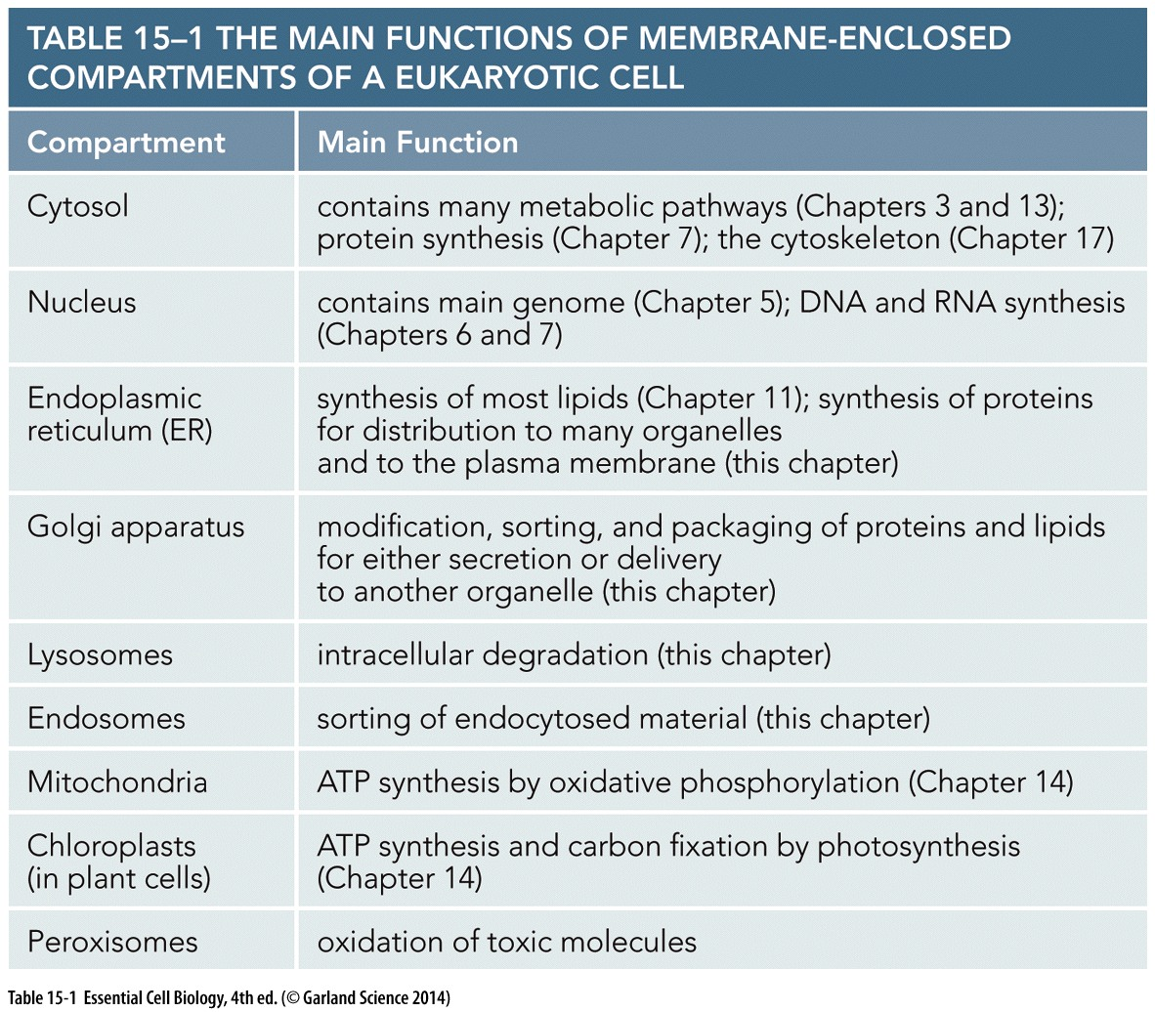
Membranes serve to partition the cell
Distinct regions have distinct functions and require distinct protein compositions
Achieved through protein transport & trafficking!

Slide 5
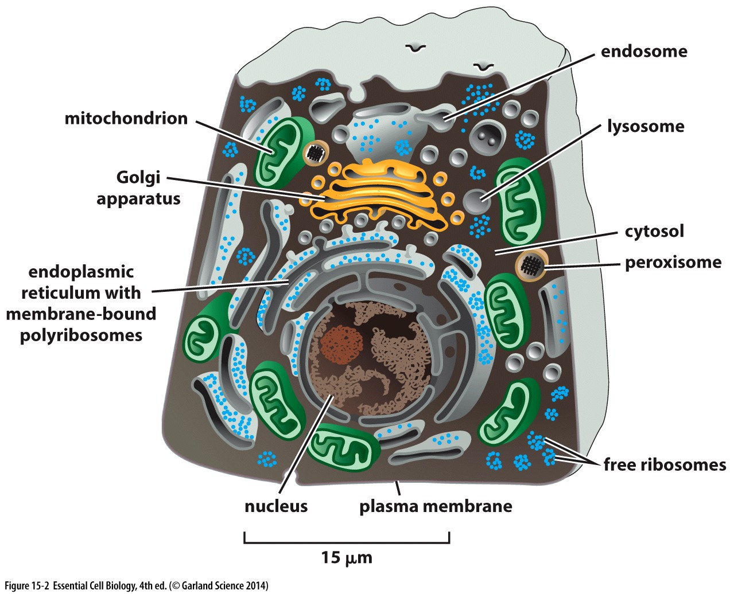
Different Organelles = Different Membranes
Eukaryotic cells
Many membrane-bound organelles
Prokaryotics cells:
No organelles
Organelles
Unique set of molecules
Specialized functions
Membranes separate distinct (incompatible) chemical reactions
Nature of the different membranes suggest different origins

Slide 6
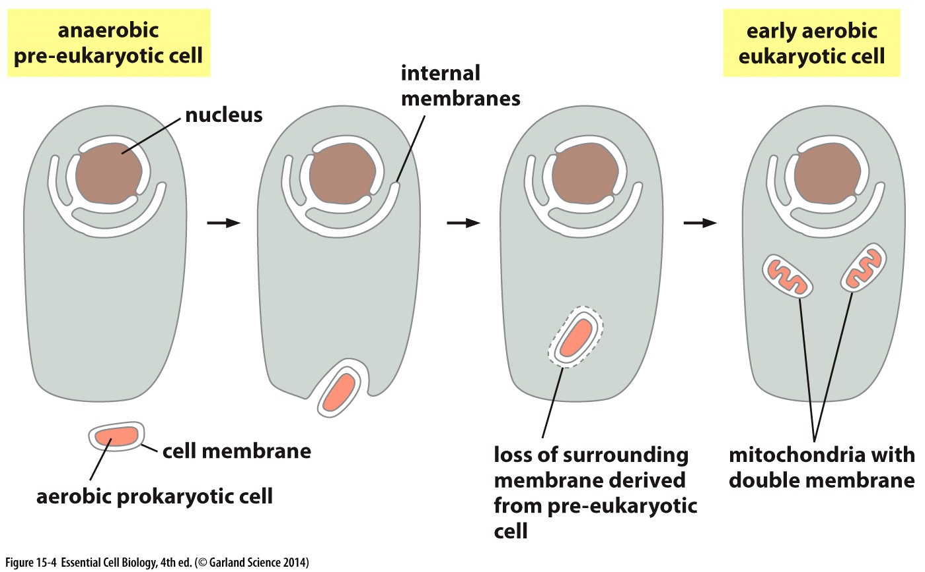
Membranes of Mitochondria and chloroplasts
Aerobic/photosynthetic bacteria engulfed by ancient eukaryotic cell (Ch 1)
Have their own genome
Proteins related to bacterial proteins
Two membranes surround them
Do not participate in vesicular transport

Slide 7
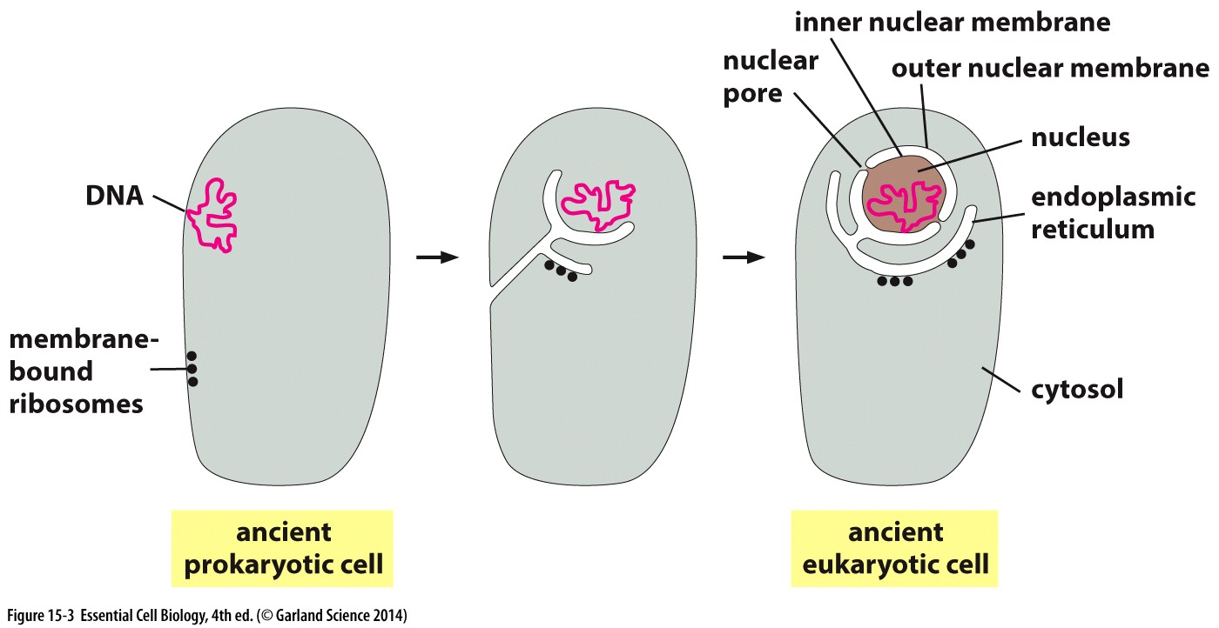
Nuclear Membrane and ER
Surrounded by a double membrane
Outer membrane is continuous with endoplasmic reticulum
Peri-nuclear (between membrane) space continuous with ER lumen

Slide 8
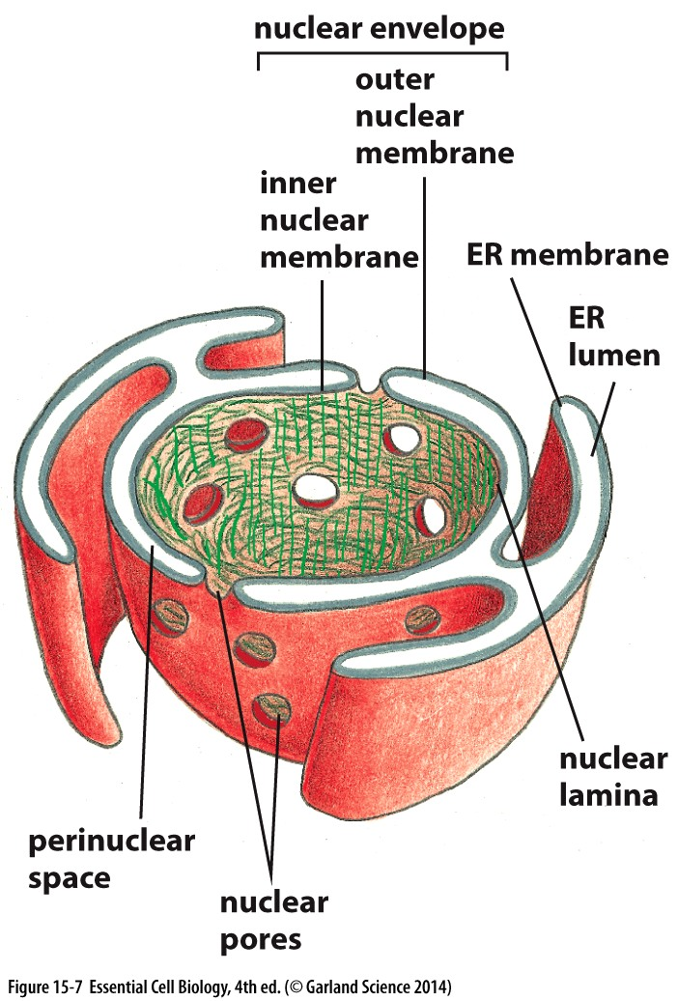
Nuclear Membrane and ER
Inner & outer nuclear membranes (joined at nuclear pores), and ER membrane are a continuous sheet
Each membrane has a distinct protein composition and function
Surrounded by a double membrane
Outer membrane is continuous with endoplasmic reticulum
Peri-nuclear (between membrane) space continuous with ER lumen
Nuclear pores penetrate both inner and outer membrane

Slide 9
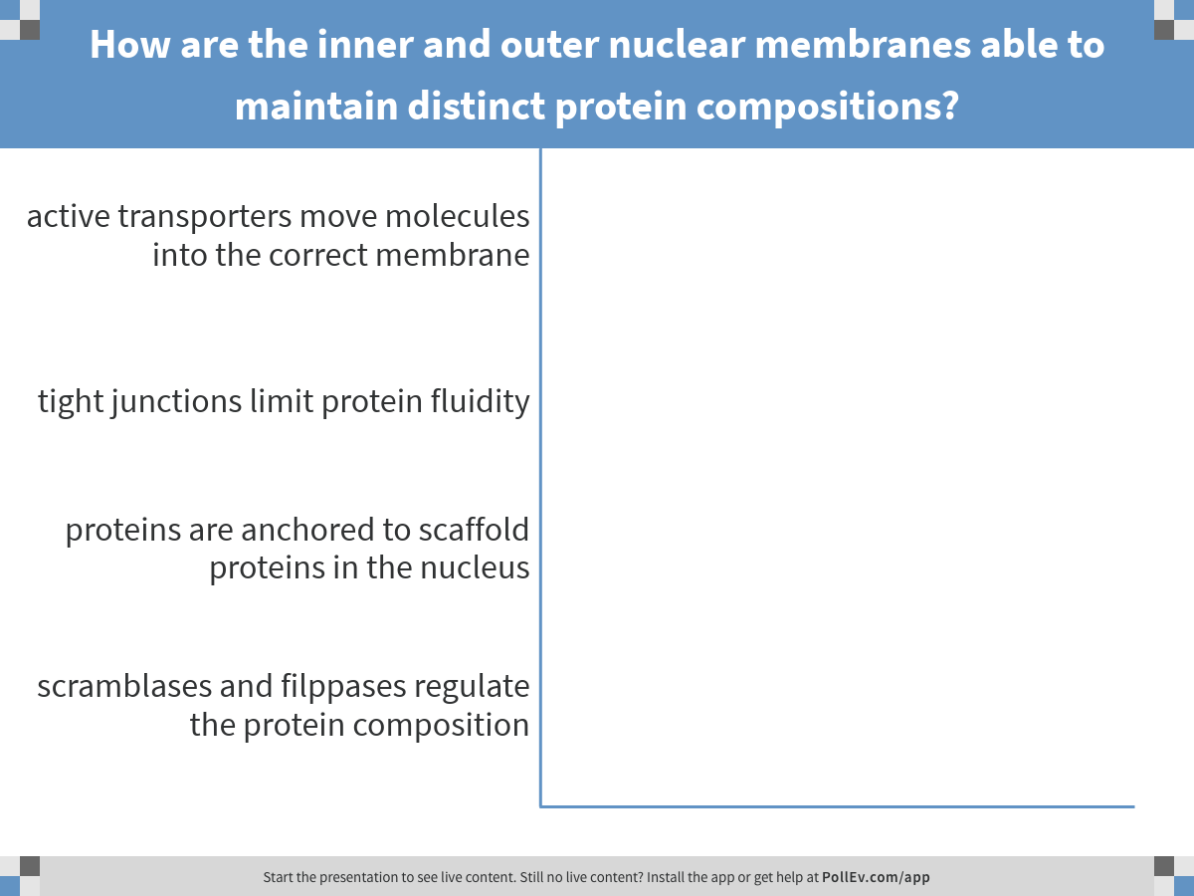
Considering that the inner and outer nuclear membranes are continuous, and lipid bilayers are fluid…
Notes:
How are the inner and outer nuclear membranes able to maintain distinct protein compositions?
https://www.polleverywhere.com/multiple_choice_polls/i8g0HguIEEs0SJH

Slide 10
Protein sorting and transport

Slide 11
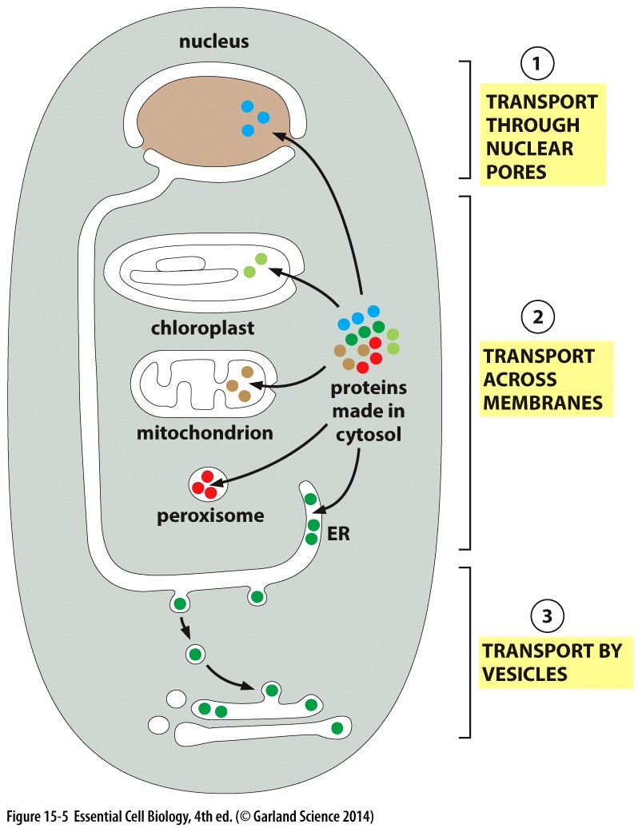
Proteins transport into organelles
Transport into organelles requires energy
Nuclear pores: into & out of nucleus
selective gates/active transporter for folded protein & other macromolecules
Free diffusion of small molecules
Translocators: from cytosol to membrane-bound organelles
Unfolded protein
Transport vesicles: between organelles
Pinch off from membrane
Folded protein & macromolecules

Slide 12
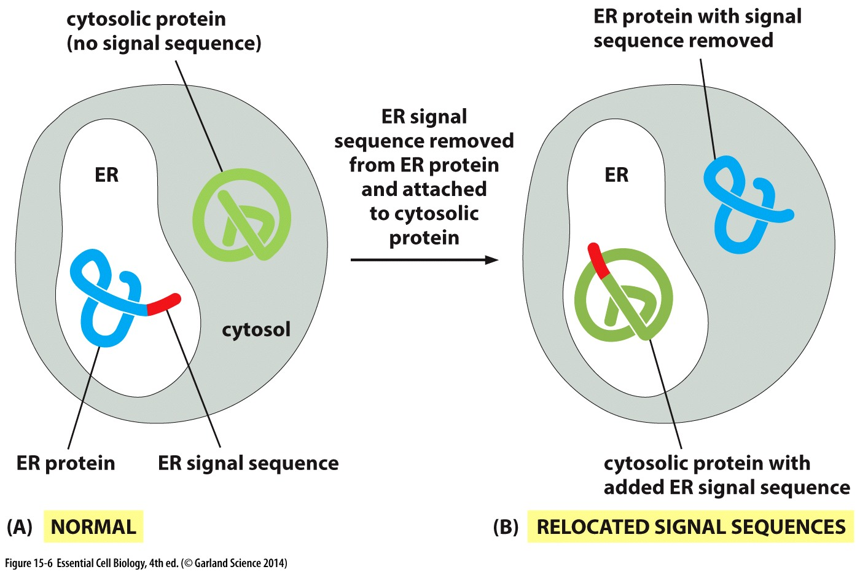
Protein-directed sorting
Distinct signal sequences for:
import into
ER
ER lumen
Mitochondria
Peroxisomes
Nucleus
Import out of nucleus
Signal is encoded in the amino acid sequence of the protein
Physical properties: hydrophobicity/charge more important than actual sequence
Often removed from the final functional protein once it is sorted
Signal is NECESSARY and SUFFICIENT

Slide 13
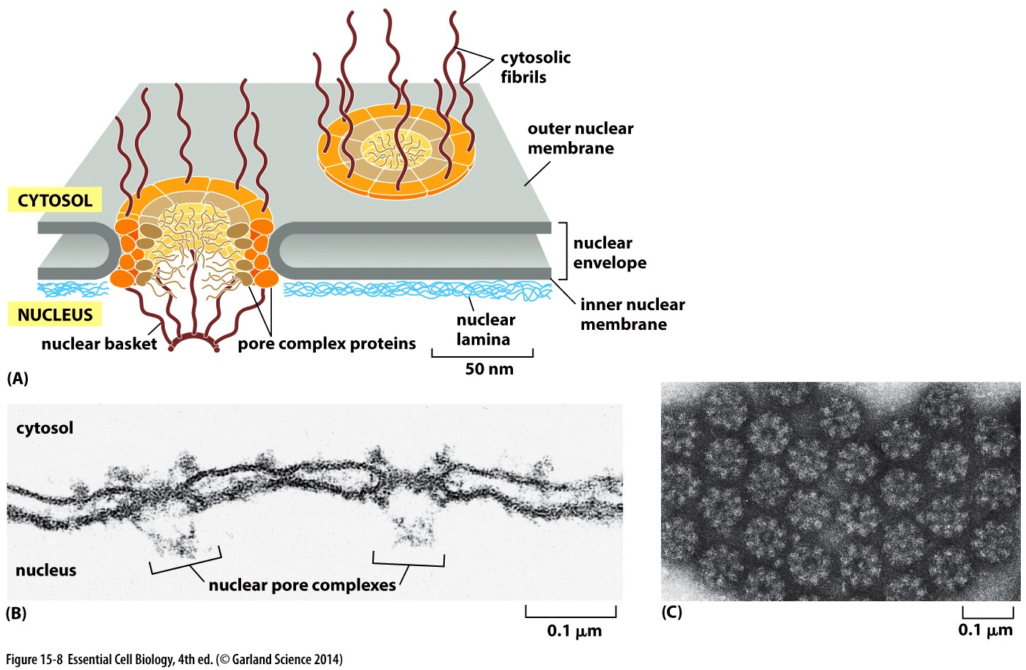
Nuclear pores
Unstructured fibrils permit passage of small water-soluble molecules
Selective gate to allow entry and exit of macromolecules
Electron micrograph: top view
Electron micrograph: side view

Slide 14
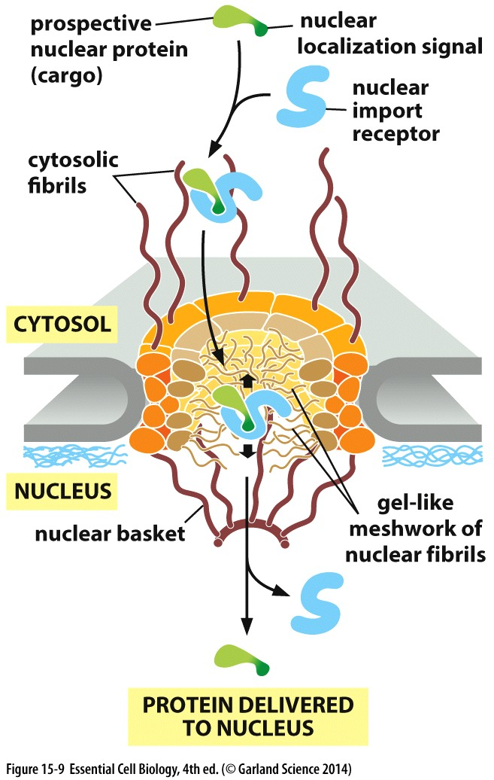
Macromolecule transport through pores
Nuclear localization signal (NLS)
Primary amino acid sequence
Nuclear import receptor
Cytosolic
Recognizes and binds NLS
Shuttles protein to the pore
Interacts with unstructured nuclear fibrils & disrupts self-interactions of repeat sequences
Passes the pore & delivers protein
Returns to cytoplasma
Repeat

Slide 15
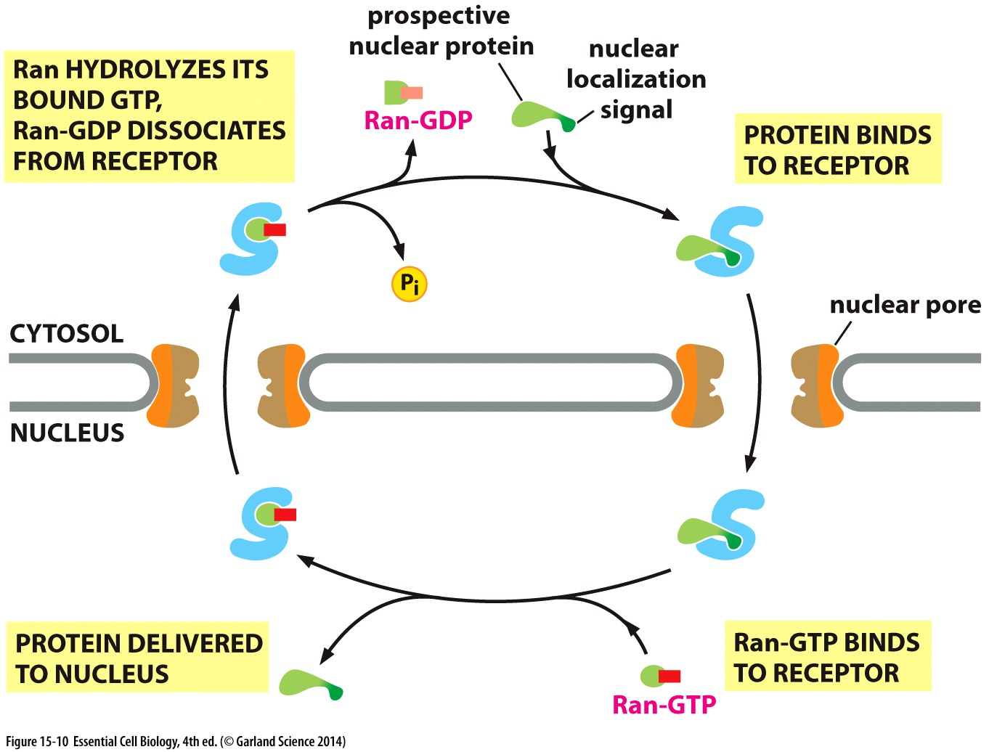
Nuclear import is regulated by GTP hydrolysis
Nuclear import receptor binds the NLS-protein
Receptor shuttles protein through the pore

Slide 16
Nuclear import is regulated by GTP hydrolysis
Nuclear import receptor binds the NLS-protein
Receptor shuttles protein through the pore
RanGTP (high conc in nucleus) binds and displaces nuclear protein
RanGTP-bound receptor leaves through pore

Slide 17
Nuclear import is regulated by GTP hydrolysis
Nuclear import receptor binds the NLS-protein
Receptor shuttles protein through the pore
RanGTP (high conc in nucleus) binds and displaces nuclear protein
RanGTP-bound receptor leaves through pore
GTP is hydrolyzed and RanGDP releases from receptor

Slide 18
Key steps to allow nuclear transport to happen
Nuclear import receptor binds the NLS-protein
Receptor shuttles protein through the pore
RanGTP (high conc in nucleus) binds and displaces nuclear protein
RanGTP-bound receptor leaves through pore
GTP is hydrolyzed and RanGDP releases from receptor

Slide 19
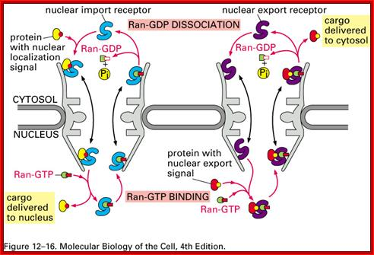
How might the RanGTP gradient be used to EXPORT nuclear proteins?

Slide 20
Import without pores
Mitochondria and chloroplasts

Slide 21
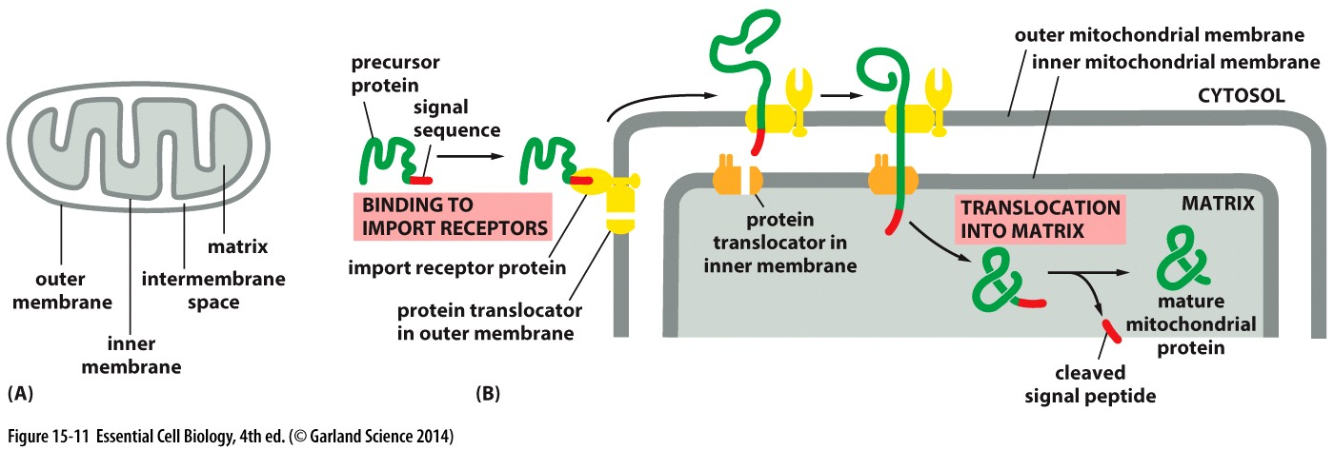
Import into mitochondria & chloroplasts
Still need signal sequence, BUT
No pores…
Instead import receptors cooperate with protein translocators in BOTH membranes
Proteins typically unfold to pass through translocators

Slide 22
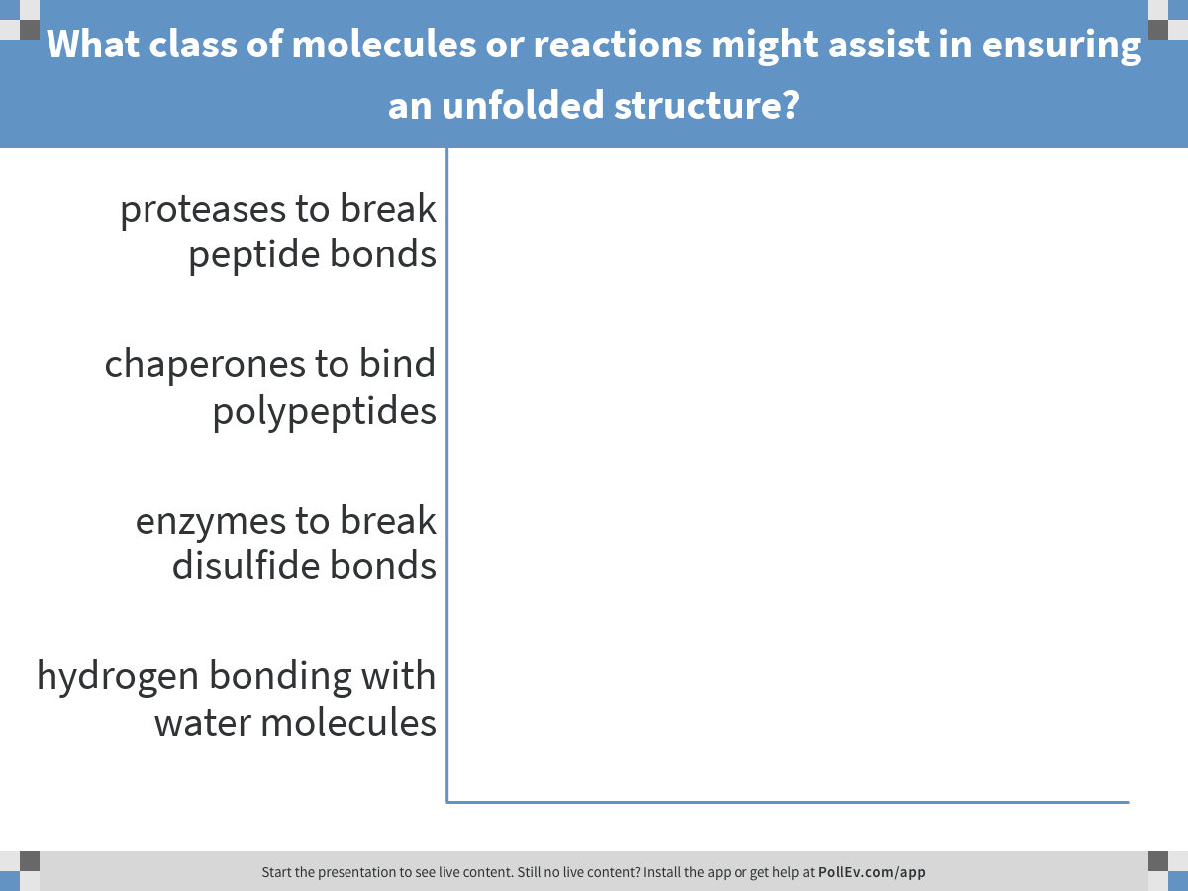
To be imported into the mitochondria, many proteins need to be unfolded.
Notes:
What class of molecules or reactions might assist in ensuring an unfolded structure?
https://www.polleverywhere.com/multiple_choice_polls/F8qgEq1qZXDzFZ8

Slide 23
To be imported into the mitochondria, many proteins need to be unfolded. What class of molecules or reactions might assist in ensuring an unfolded structure?
Answer
Explanation
Proteases to break peptide bonds
Chaperones to bind polypeptides
Enzymes to break disulfide bonds
Hydrogen bonding with water molecules
Breaking the peptide backbone would fragment the protein- wouldn’t re-fold
Chaperones reversibly maintain unfolded state
cytosolic proteins don’t typically have disulfide bonds
Won’t disrupt folded structure Ionic bonds and hydrophobic interactions that maintain folding are stronger than H-bonds

Slide 24
Import without pores
Endoplasmic Reticulum (ER)

Slide 25
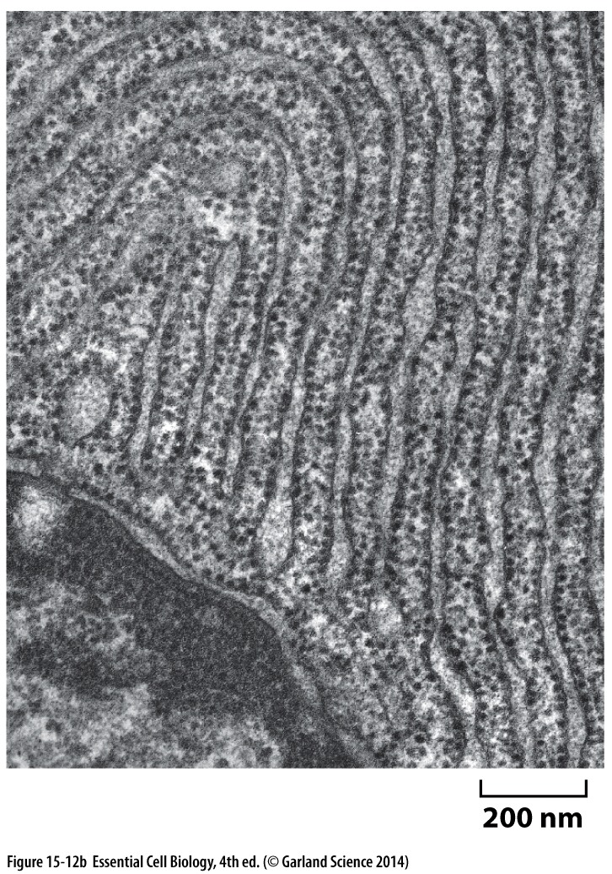
Import into the ER
Most extensive membrane system of the cell
Protein trafficking hub
Source of membrane for other organelles growing cell
Proteins are synthesized on the subset of ribosomes bound to the outer ER membrane
Soluble proteins transported into the ER lumen
Transmembrane proteins inserted into the ER membrane
‘Rough’ ER

